Slide 1
05-Config_Data_in_Kubernetes

Slide 2
What you will learn in this course 🧐🧐
An important part of Kubernetes is how to handle configuration data like environment variables in your cluster. In this course, we will be learning about two important resources:
Secrets
ConfigMaps
Let's dive right in 🤿

Slide 3
Demo App
Let's say we would like to deploy an MLflow Server. If you are not familiar with the library, it is basically a way for Data Scientist to collaborate. Think of it as the git for Data Scientists. With it, you will be able to track each training job with an ML Model's parameters, performance etc.
To set that up, you need:
To create a web server - To showcase your models' performance
To create an S3 Bucket - To store the models' artifacts (files to be able to use the model remotely)
To create a SQL BDD - To store mlflow metadata
If you want more information - check out this documentation 👉 MLflow with remote Tracking Server, backend and artifact stores
Bottom line is there are four environment variables you need to setup:
BACKEND_STORE_URI - SQL DB
ARTIFACT_ROOT - S3 Bucket
AWS_ACCESS_KEY_ID - AWS Creds
AWS_SECRET_ACCESS_KEY - AWS Creds

Slide 4
Demo App
Now here is what the app would look like in Kubernetes:
|- working_directory |-- mlflow_deployment.yaml |-- mlflow_service.yaml |-- mlflow_ingress.yaml
mlflow_deployment.yaml will handle the Deployment resource
mlflow_service.yaml will handle the Service resource
mlflow_ingress.yaml will handle the Ingress resource
In this course, we are not going to talk about mlflow_service.yaml or mlflow_ingress.yaml as they are only here to make the app accessible from the outside world. If you want to check out the whole code directly, feel free to download the full code in the resources of this course.
👋 If you are not comfortable with Service & Ingress resources, feel free to check-out Build your first Kubernetes cluser course.

Slide 5
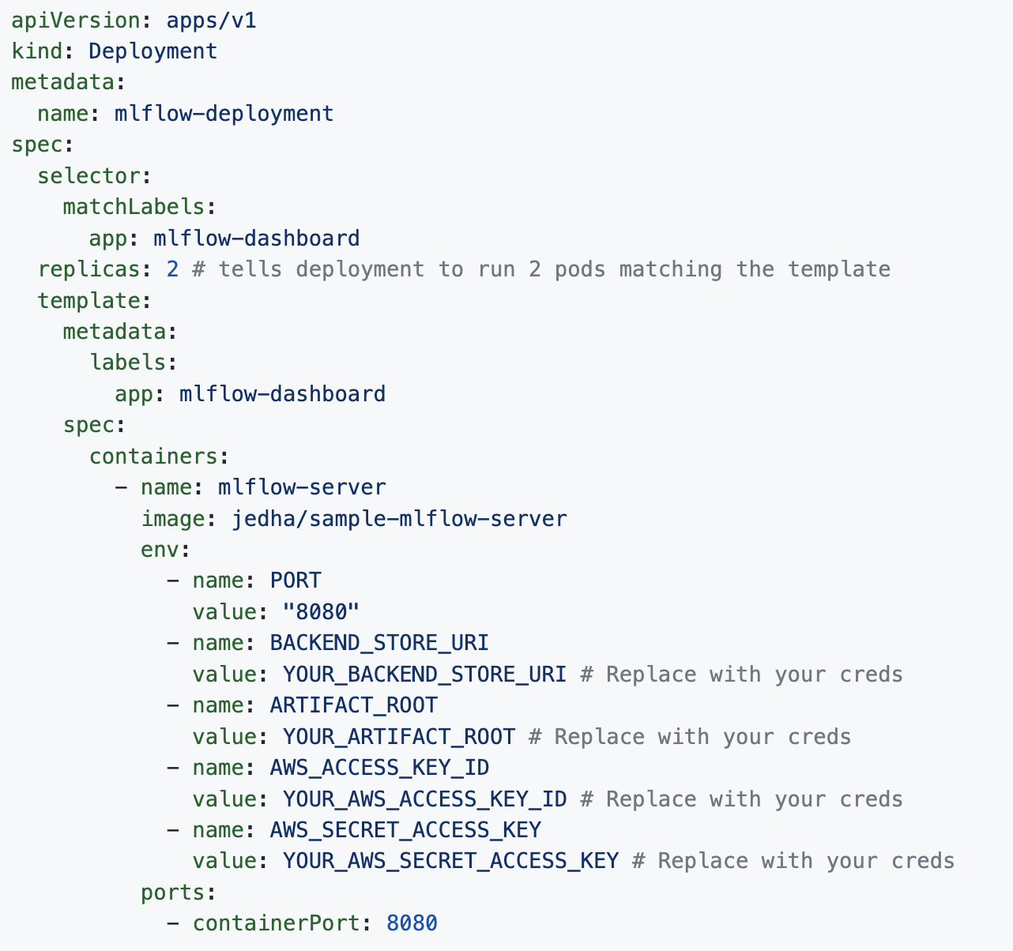
Handle Environment variables locally
To handle environment variables within Kubernetes, the easiest way is simply to specify it within the spec of your containers:

Slide 6
Handle Environment variables locally
If you run:
kubectl apply -f mlflow_deployment.yaml along with
kubectl apply -f mlflow_service.yaml &
kubectl apply -f mlflow_ingress.yaml
Your app will be up and running.
👋 Don't forget to enable ingress in minikube minikube addons enable ingress and run minikube tunnel before you check out your app
Now there are one huge problem when going with this option - Environment variables are hard coded in your config file 🙅. You definitely don't want to have that, especially if you are going to push your code to Github! Therefore here is a good alternative.

Slide 7
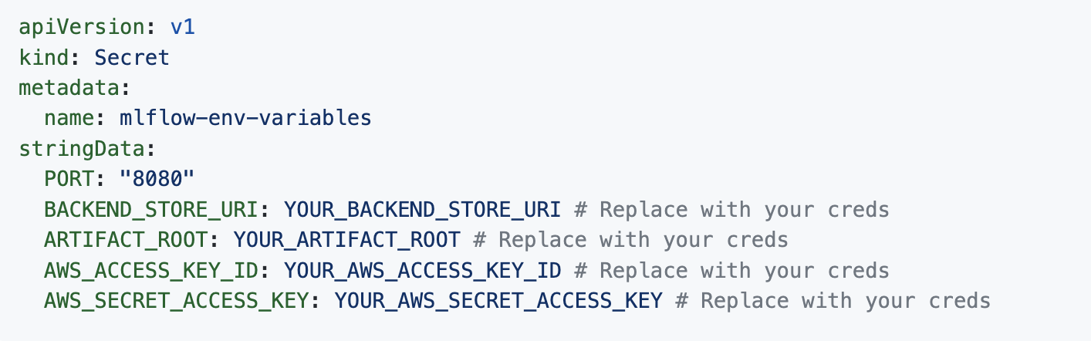
Secrets
A Secret resource in Kubernetes is a good way of handling sensitive data accross your cluster. To create a secret all you have to do is to create a new file called: mlflow_secrets.yaml with the following content:

Slide 8
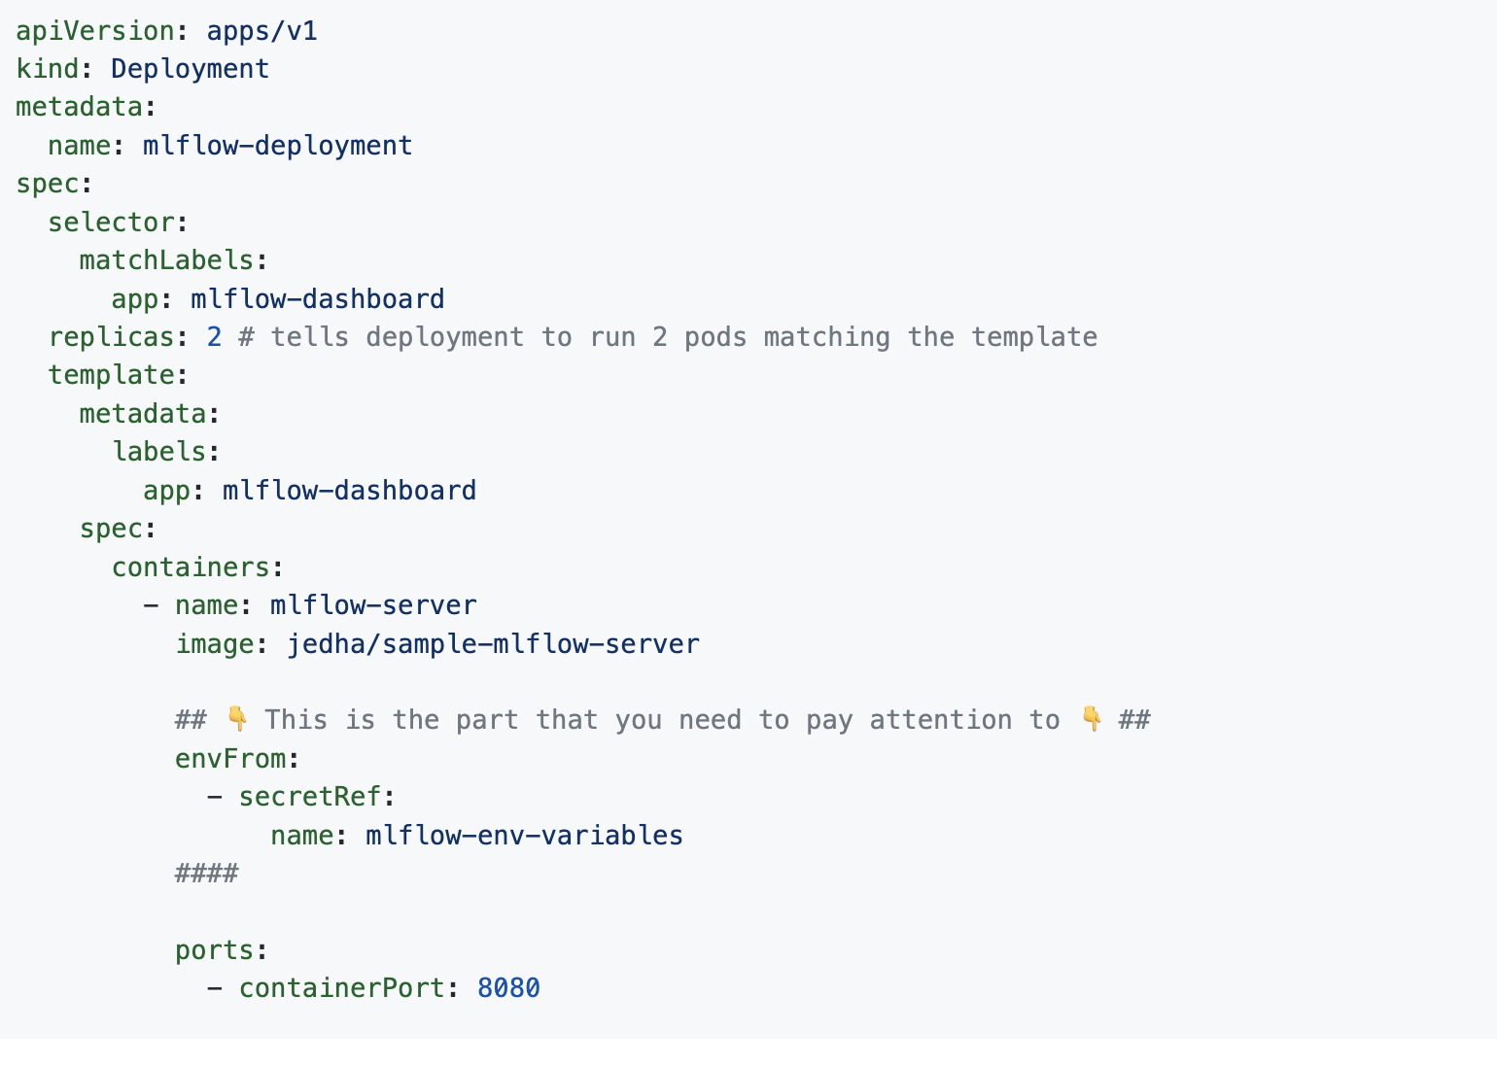
Secrets
Now to use Secrets, simply change mlflow_deployment.yaml like this:

Slide 9
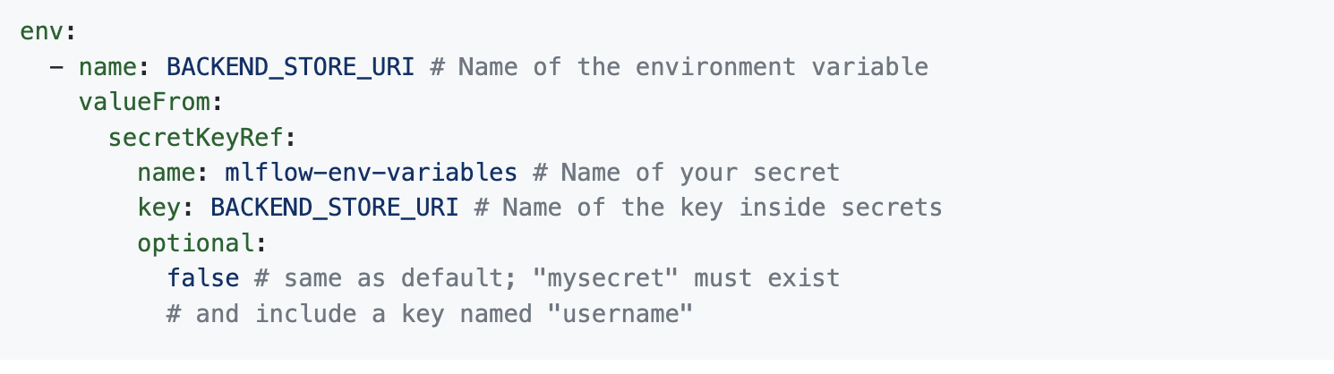
Secrets
Here, we bring all the environment variables into each container. If you want to use only some of them, you can simply replace:
By

Slide 10
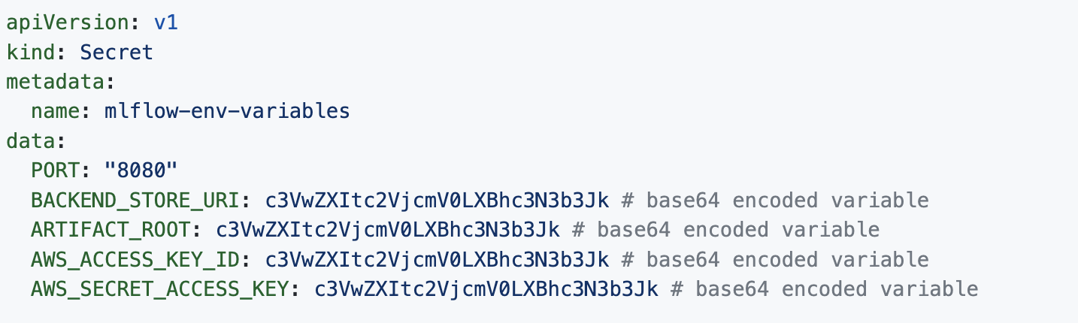
Secrets
👋 FYI, there are other ways to use Secrets. One that you might encounter is the opaque type of Secrets where you will need to encode your environment variables in base64. Instead of looking like the one of the above, it would look like this:
It is common to see examples like this as opaque is the default Secret type in Kubernetes. If you need to encode data in base64 very simply, just run:
echo "VARIABLE_VALUE_TO_ENCODE" | base64
⚠️⚠️ Now that you environment variable are stored in a seperate file, you will be able to take it out of your Version Control System (like git) and therefore don't expose secrets to the public.

